Slide 1


Slide 2


Slide 3


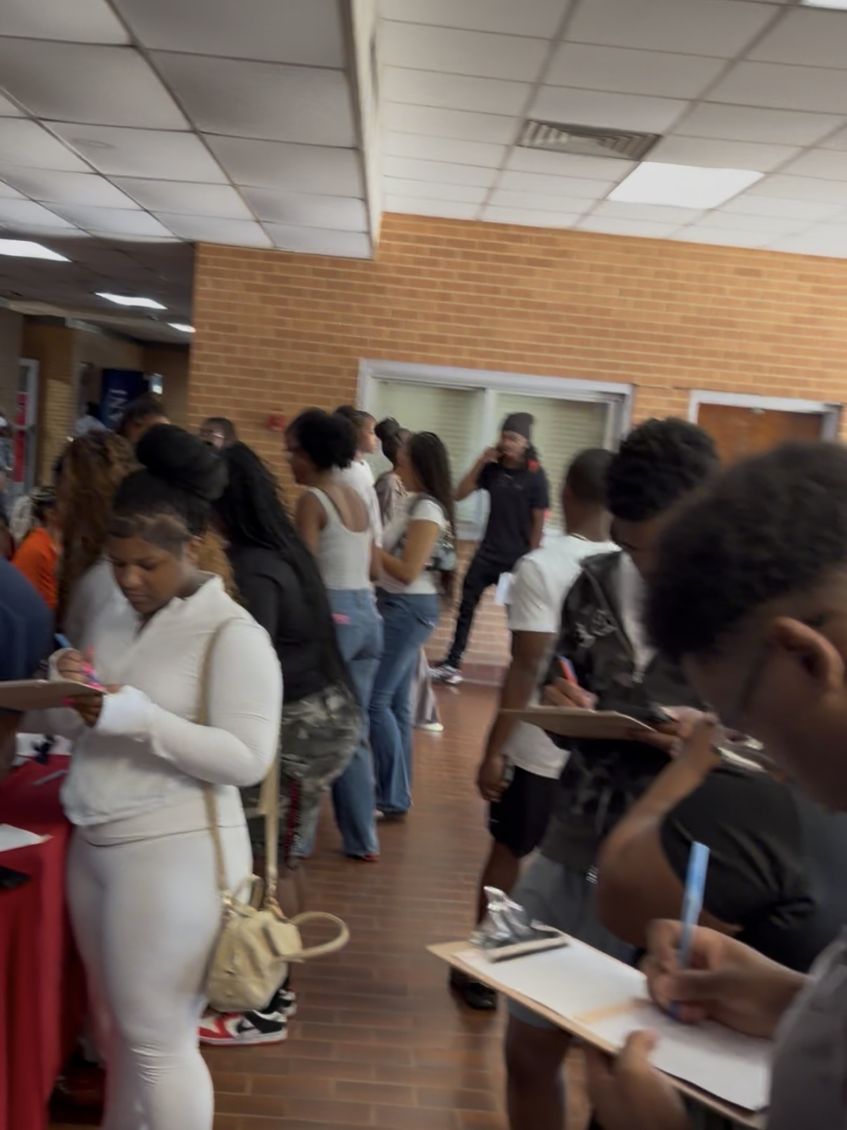
Friday, August 14, 2026:
508 First-Year Students
Voter Registration:
162 First-Year Students

Slide 4

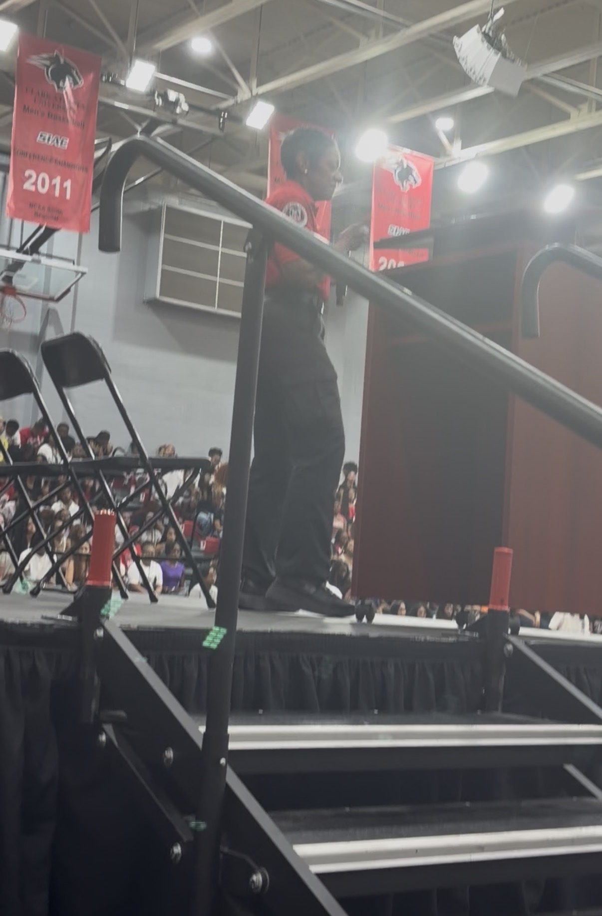
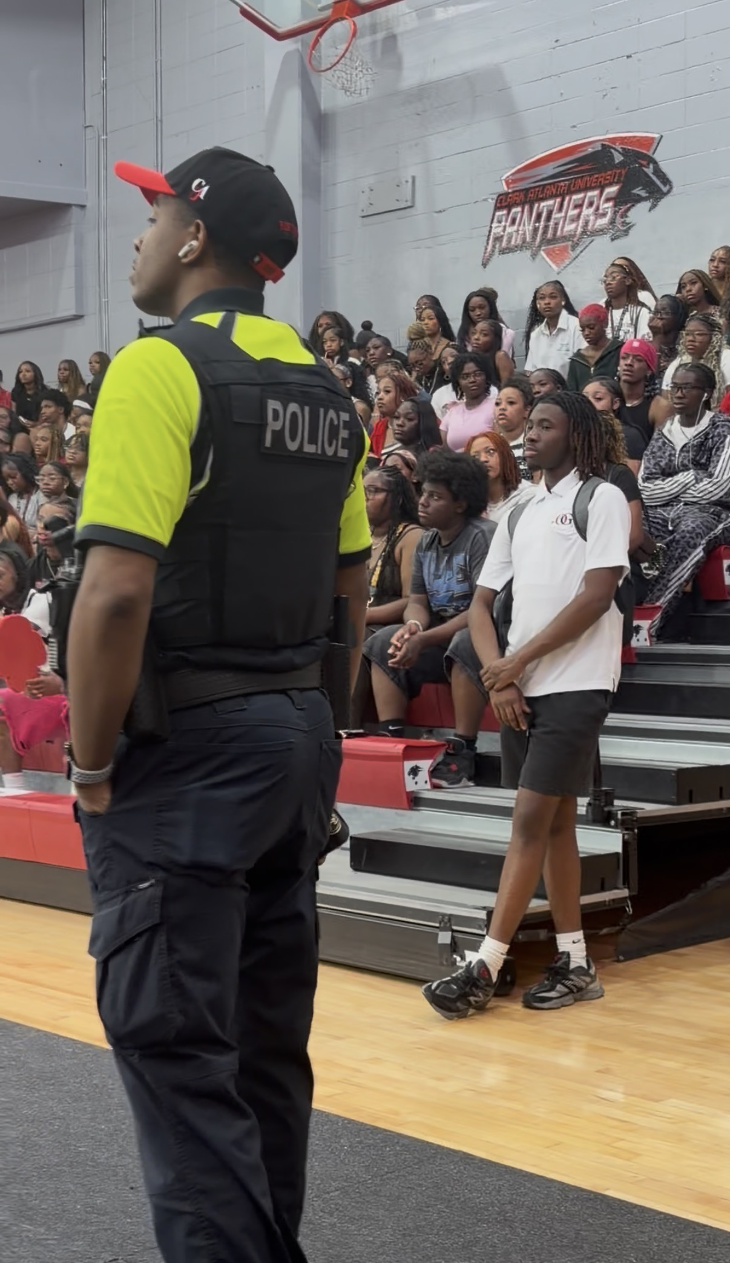
Saturday, August 15, 2026:
634 First-Year Students

Slide 5


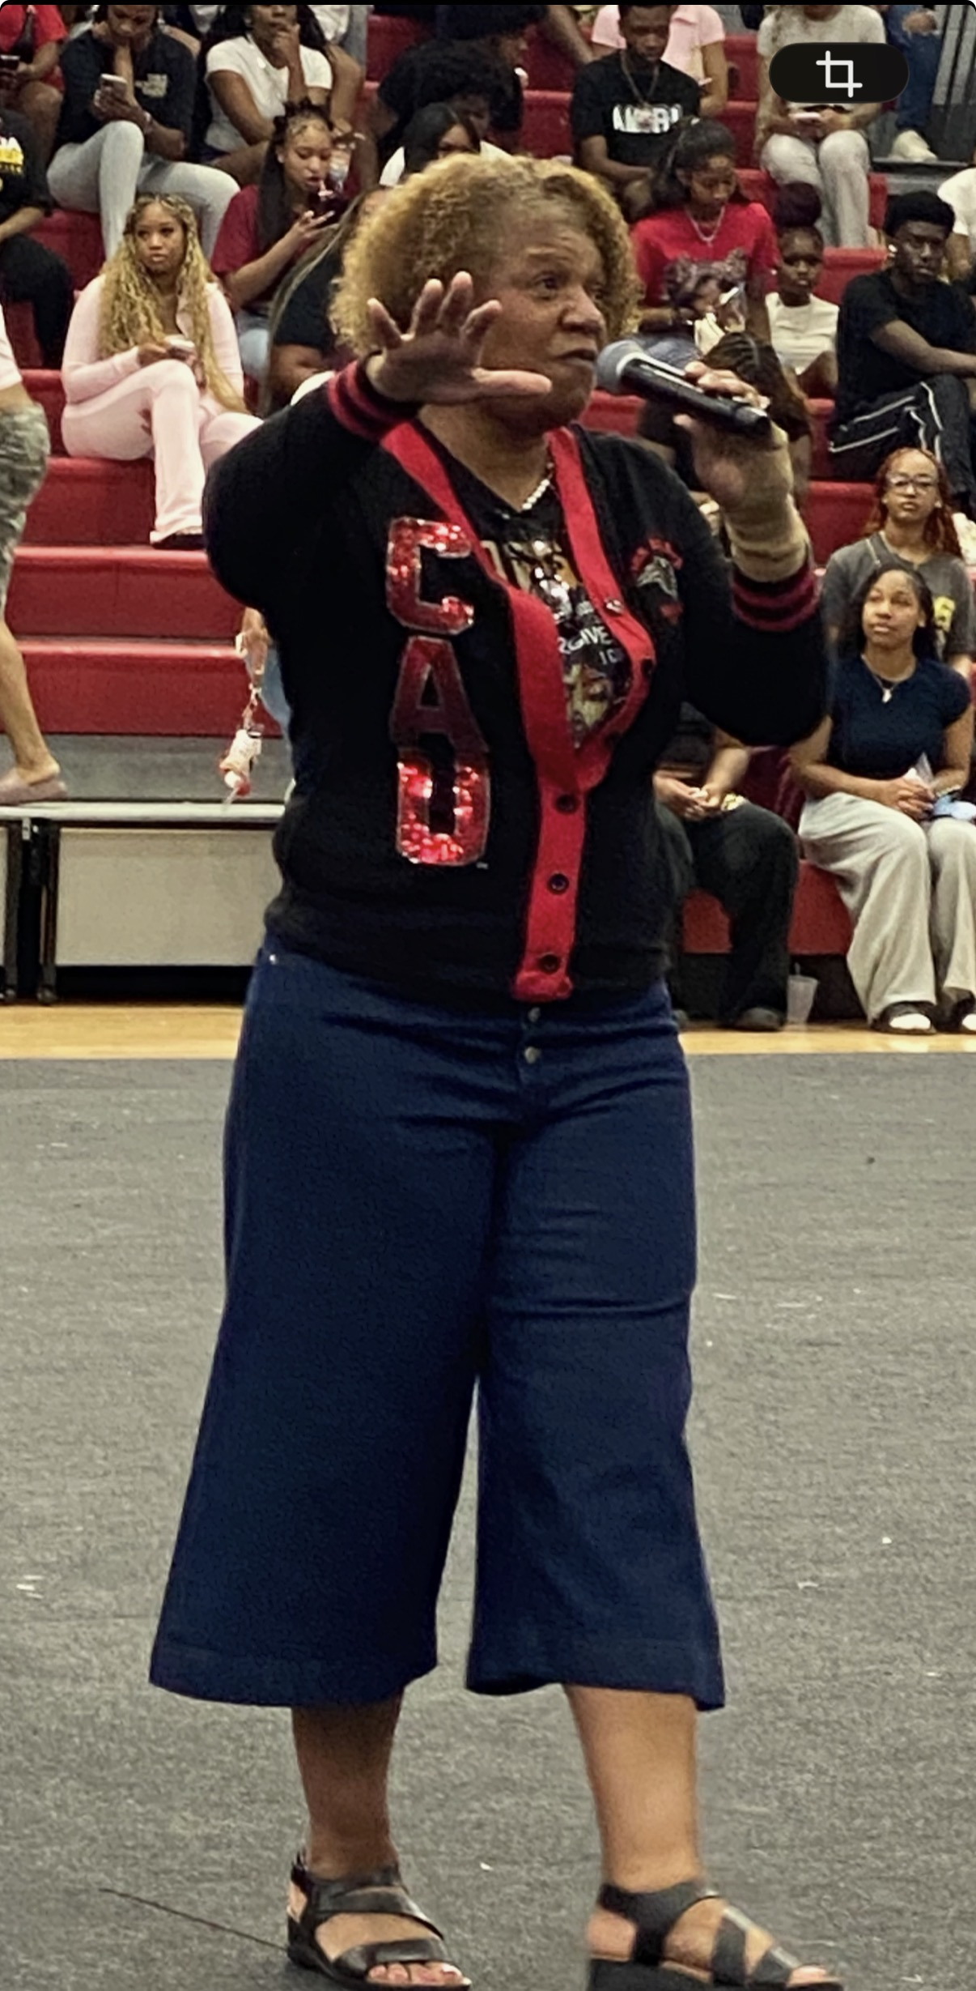
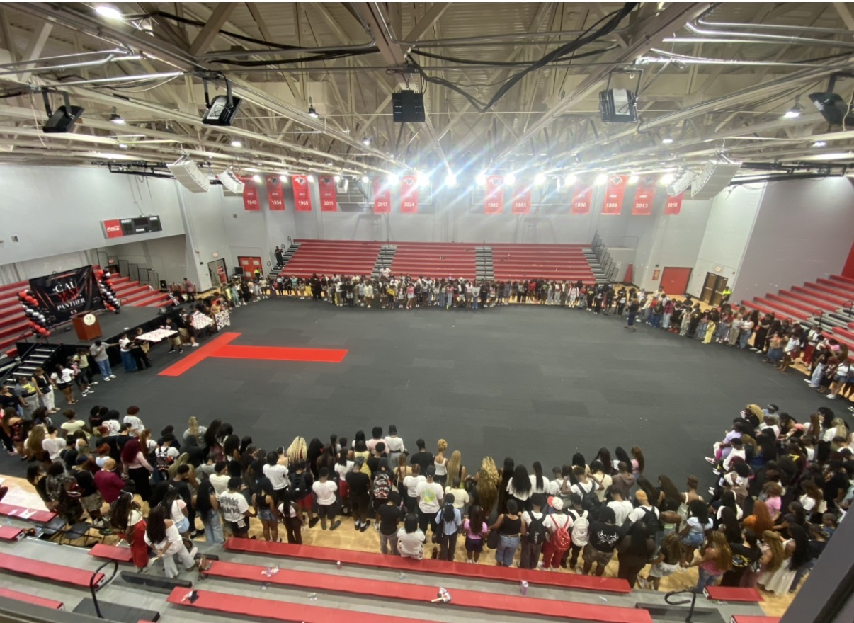
Sunday, August 15, 2026:
405 First-Year Students

Slide 6

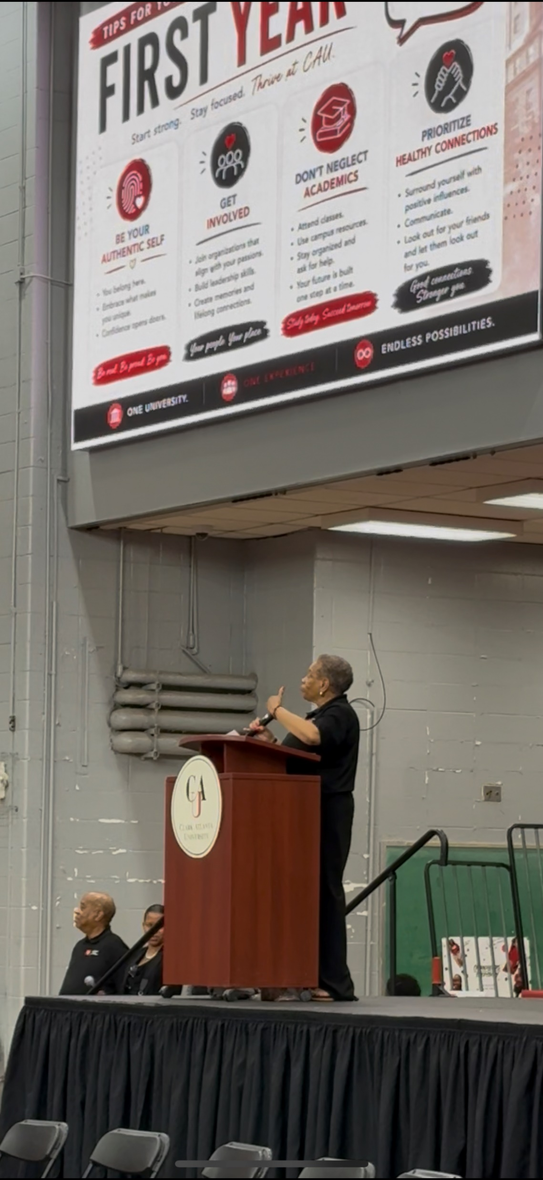
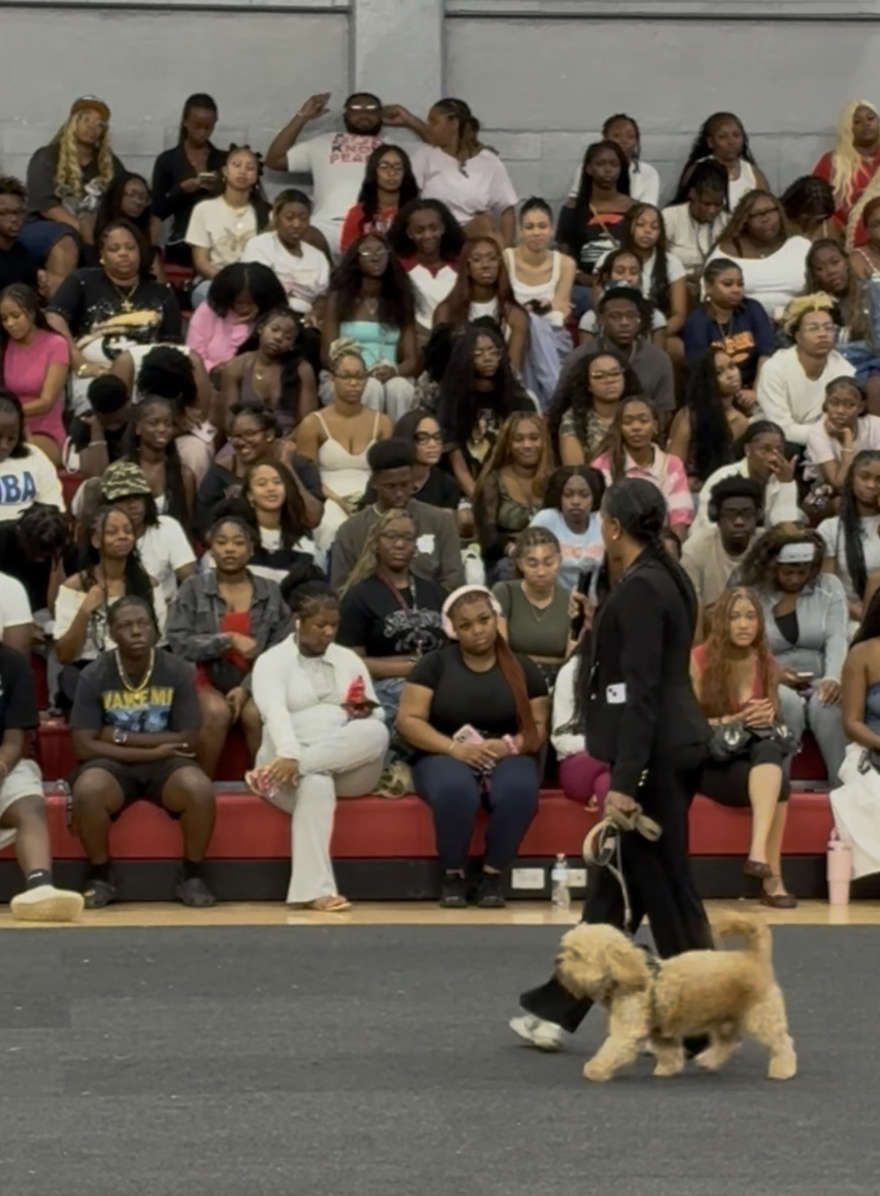
Monday, August 17, 2026:
145 First-Year Students

Slide 7


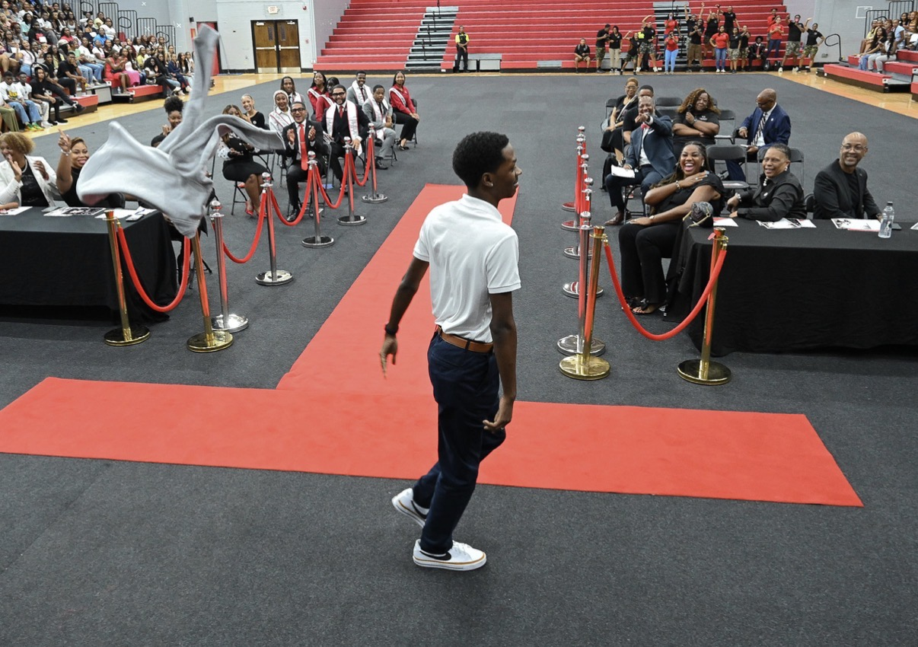
Tuesday, August 18, 2026:
471 First-Year Students

Slide 8
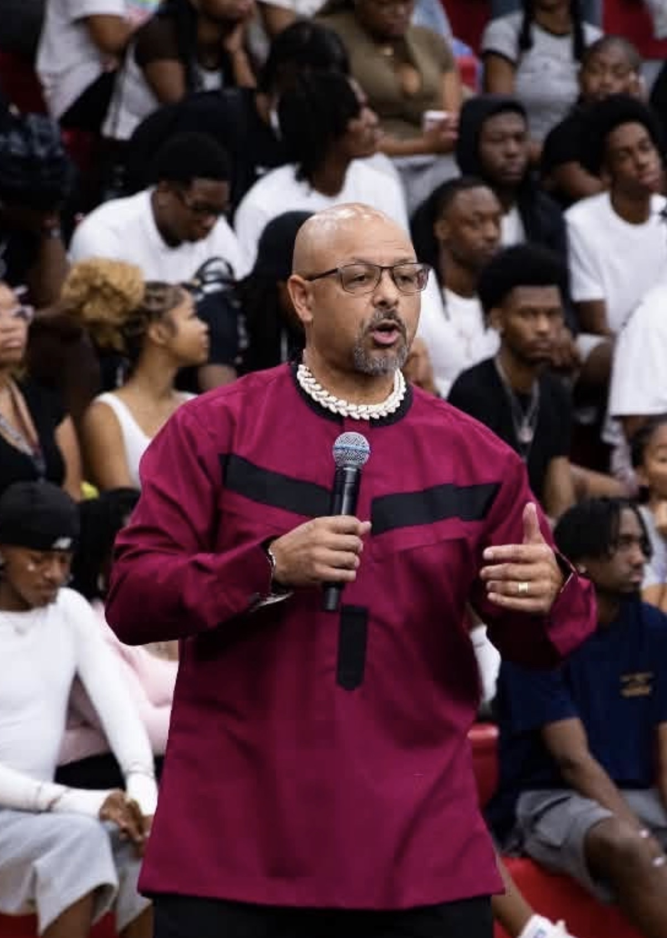

As part of the CAU Panther First-Year Development Program, each first-year student will receive a copy of Dr. Chike Akua’s Book.

