Slide 1
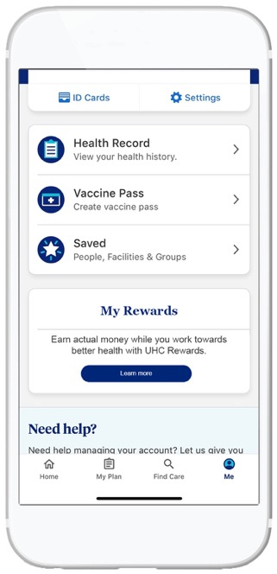

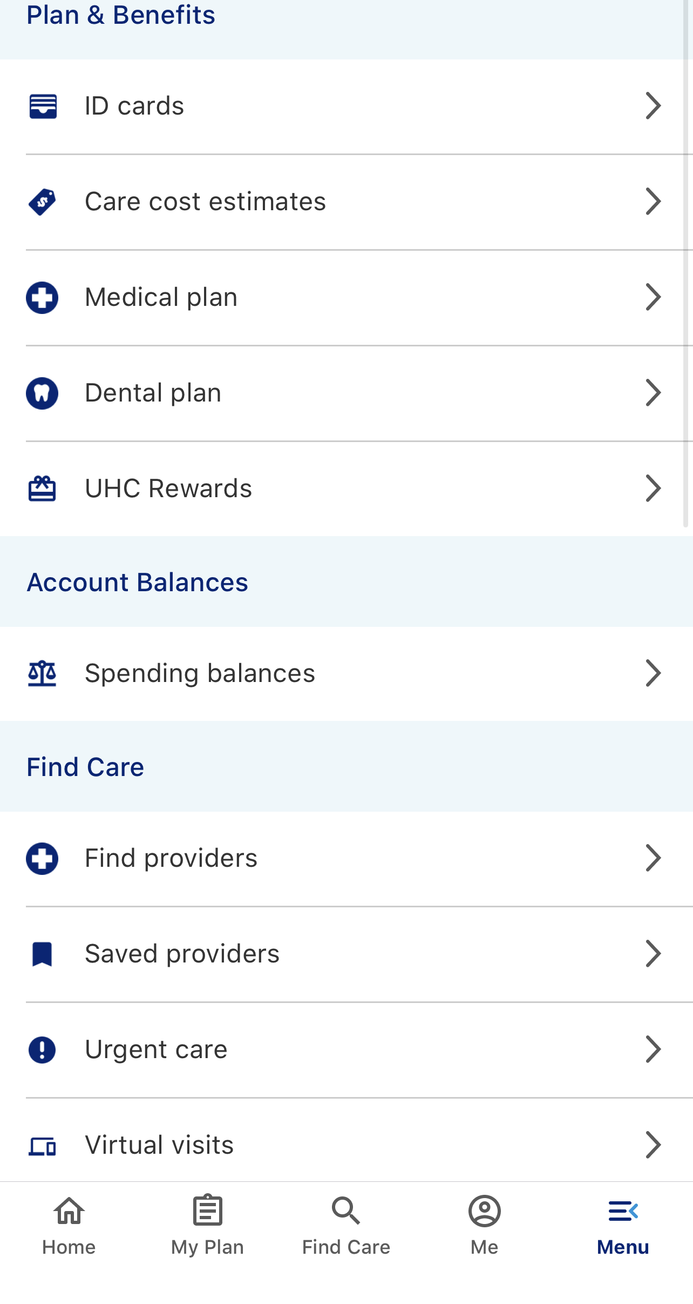
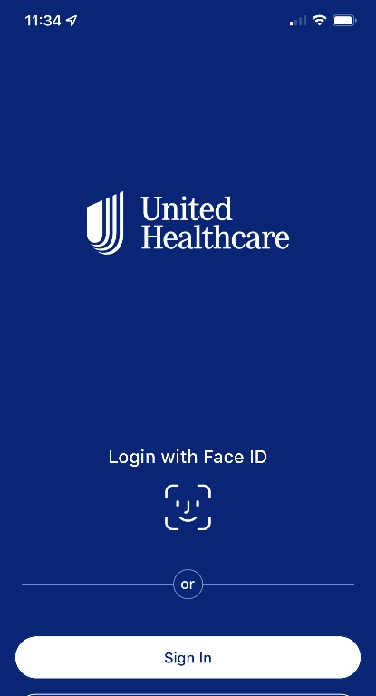


Digital health plan ID cards
Digital Support | Digital Experience
Digital health plan ID card is like a physical health plan ID card including all the information necessary to verify health plan coverage. Available through the UnitedHealthcare® app and myuhc.com ®. The digital health plan ID card works the same as a physical health plan ID card. Simply show it at a doctor’s office, clinic, pharmacy or wherever benefit information needs to be presented.
Opting into paperless communications automatically gives employees their digital health plan ID card.
To view on myuhc.com:
1. Log in to myuhc.com, using HealthSafe ID® credentials (existing login and password for myuhc.com® or the UnitedHealthcare® app). If you do not have a HealthSafe ID®, follow the instructions to register.
2. Click View & Print Member ID Cards
To view on UnitedHealthcare® app:
1. Log into the app using your HealthSafe ID® credentials (existing login and password for myuhc.com® or the UnitedHealthcare® app). If you have not downloaded the UHC app, access the App Store® and search for UnitedHealthcare. Download the UnitedHealthcare® app.
2. Click on View ID Cards
Notes:
REMOVE THIS SLIDE IF USP GROUP
Digital health plan ID card is like a physical health plan ID card including all the information necessary to verify health plan coverage. Available through the UnitedHealthcare® app and myuhc.com ®. The digital health plan ID card works the same as a physical health plan ID card. Simply show it at a doctor’s office, clinic, pharmacy or wherever benefit information needs to be presented.
Subscribers who have previously selected “paperless” for Required Communications in their myuhc.com or UHC app experience will be automatically moved to a digital medical ID card experience. They will not receive a physical copy of their ID card.
For those subscribers that are brand new to a UHC sponsored plan, the medical ID card will be printed and mailed as per usual. All medical ID cards after the first plan year will follow the subscriber’s paperless ID card preference selection. This includes scenarios where a subscriber moves to a different plan and then comes back in a future year (same employer/policy).
Deploying in October 2023 (in waves from 10/4 – 10/31), an email communication will be sent to all subscribers who have elected “paperless” (~4.3M emails). Paperless setting can be changed at any time by the subscriber and a physical medical ID Card will remain available upon request.

Slide 2
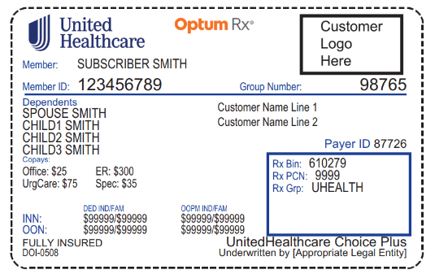
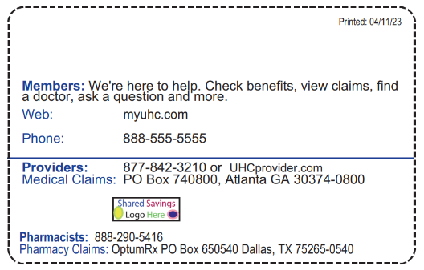
Medical ID Cards
Cards are generated and mailed 2-3 business days after eligibility has been loaded.
An image of the card will feed to myuhc.com after the ID card has been printed. Members will be able to view the image beginning on their effective date.
Subscribers will receive 2 cards. Cards include Subscriber name and up to 4 dependent names printed on the card. Additional dependents will be printed on another card.
Notes:
Medical plans with embedded Ded and OOP

Slide 3
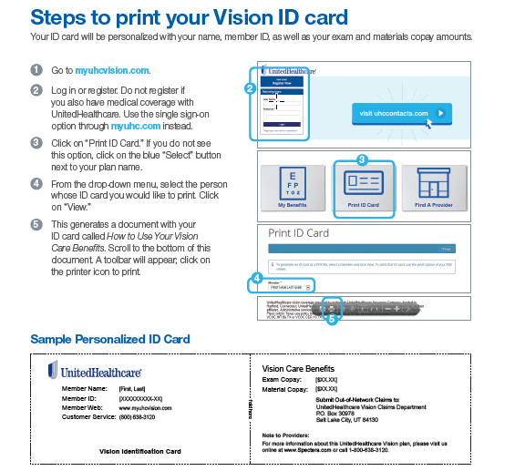
Vision ID Card
Notes:
Please remove if Vision does not apply

Slide 4

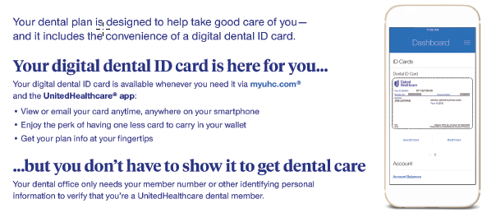

Digital Dental PPO ID Card
*Medical and Dental ID numbers will be the same but Dental will have a separate system generated group number. Members will receive physical ID cards for dental(state mandate)
Notes:
Please remove if Dental Does not apply

